Slide 1
Flickr Geo Data Visualization
Gayatri Ghanakota, Alexandru Simion, Shaosong Li,
Spencer Fink, Joseph Wuthrich

Slide 2
Project Goal
Process data from Flickr API to generate a map which displays the count of images at each location when a particular tag is searched.

Slide 3
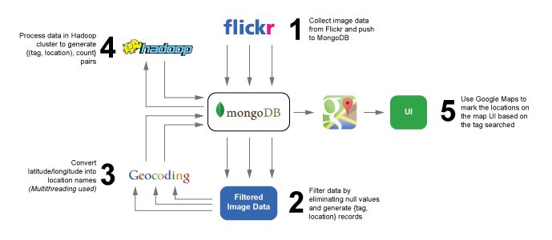

Slide 4

Frameworks
Hadoop
Django Framework for Web App
ExecutorService Framework for Multithreading.

Slide 5



Programming Languages
Python
Java
HTML5, Javascript, CSS3

Slide 6
APIs
Flickr API
Pulls image data from Flickr servers
Google Geocoding API
Lat/Lon location conversion
Google Maps API
Places markers on map UI based on tag information

Slide 7

Database
Document database that provides high performance, high availability, and easy scalability.

